Slide 1

WAY TO ENTERPRISE
AWS
VTI ACADEMY
Author: duy.nguyenngoc1@vti.com.vn

Slide 2
Agenda
CloudFormation Service
Well-Architected Framework
Other Services
Review
Exam Tutorial
Copyright © VTI Academy All Rights Reserved

Slide 3
Infrastructure as Code
Currently, we have been doing a lot of manual work
All this manual work will be very tough to reproduce:
  In another region
  In another AWS account
  Within the same region if everything was deleted
Wouldn’t it be great, if all our infrastructure was… code?
That code would be deployed and create / update / delete our infrastructure

Slide 4
CloudFormation Service
Is service that allows create and manage AWS resources based on code (most of AWS resources are supported)
Infrastructure as code
Ex: within a CloudFormation template, you say:
  I want a security group
  I want two EC2 machines using this security group
  I want an S3 bucket
  I want a load balancer (ELB) in front of these machines
🡺 Then CloudFormation creates those for you, in the right order, with the exact configuration that you specify

Slide 5
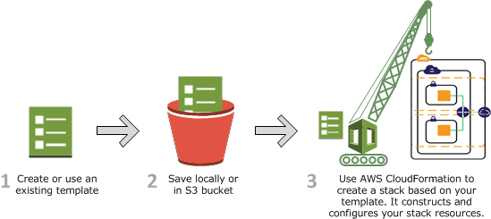
CloudFormation Service
The code can be version controlled for example using git
Usecases
  Quickly Launch New Test Environments
  Reliably Replicate Configuration Between Environments
  Launch Applications in New AWS Regions
  Manage infrastructure with DevOps
Price: free - https://aws.amazon.com/cloudformation/pricing
Tutorial: https://docs.aws.amazon.com/AWSCloudFormation/latest/UserGuide/Welcome.html

Slide 6
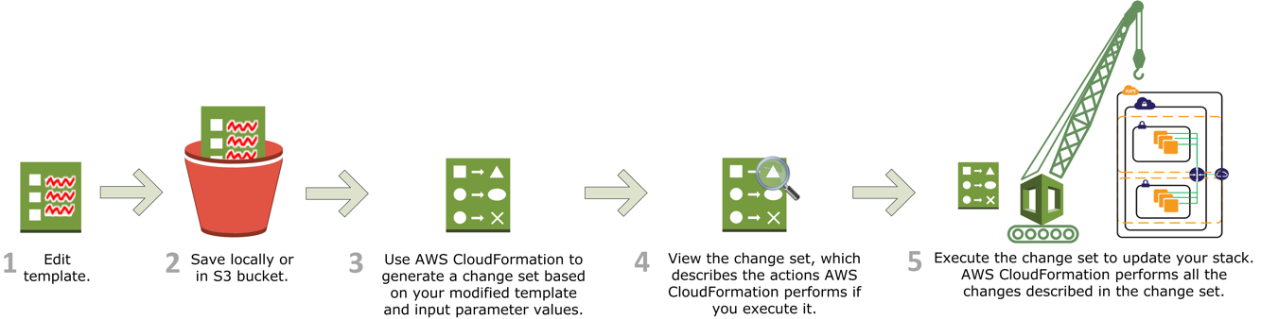
CloudFormation Service
Flow
Create
Update

Slide 7
CloudFormation Service
Demo
  Create Template
  Create Stack
  Update Stack

Slide 8
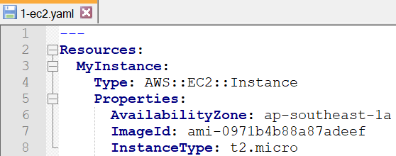
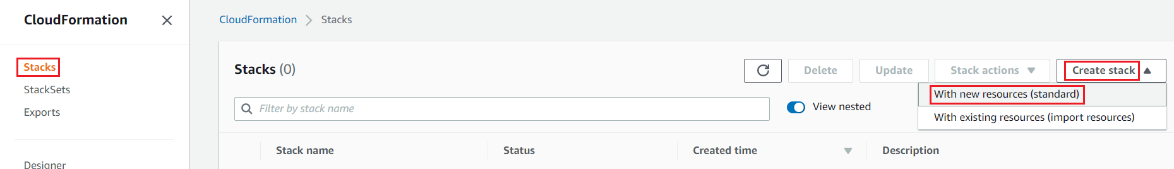
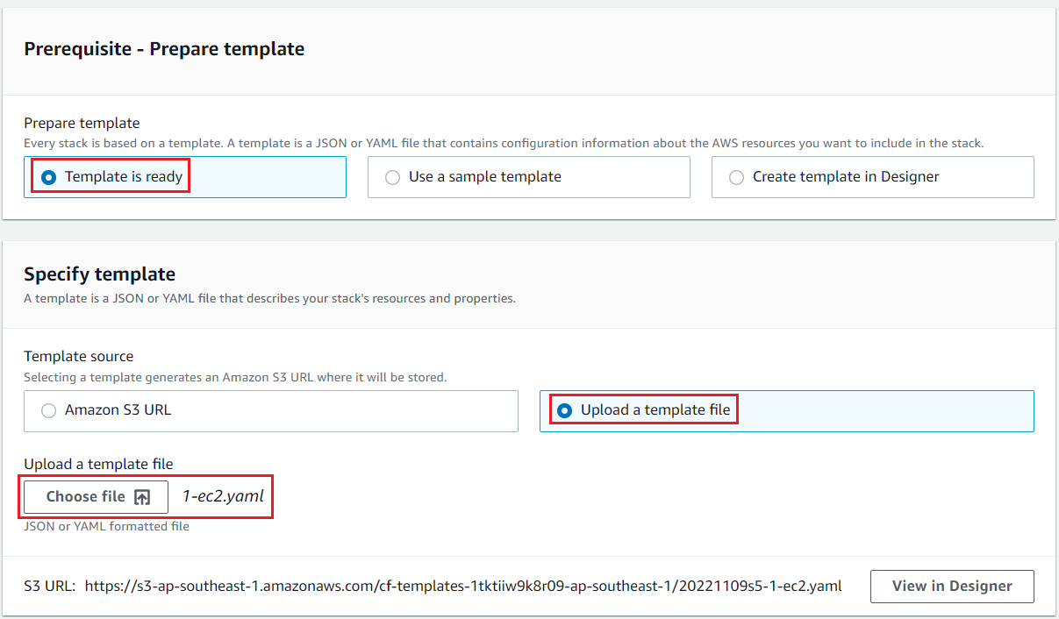
CloudFormation Service
  Create Template
  Create Stack

Slide 9
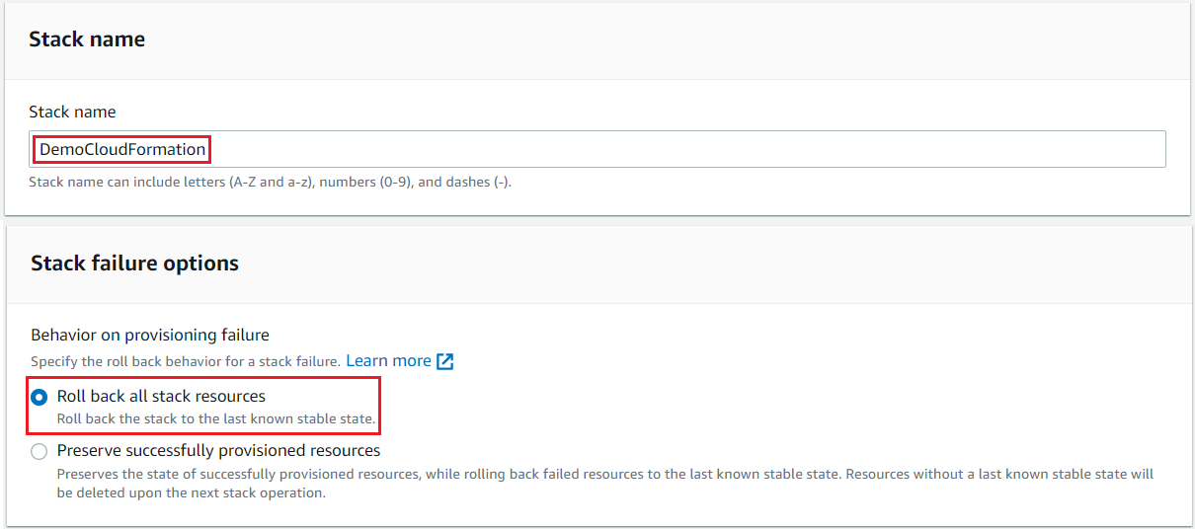
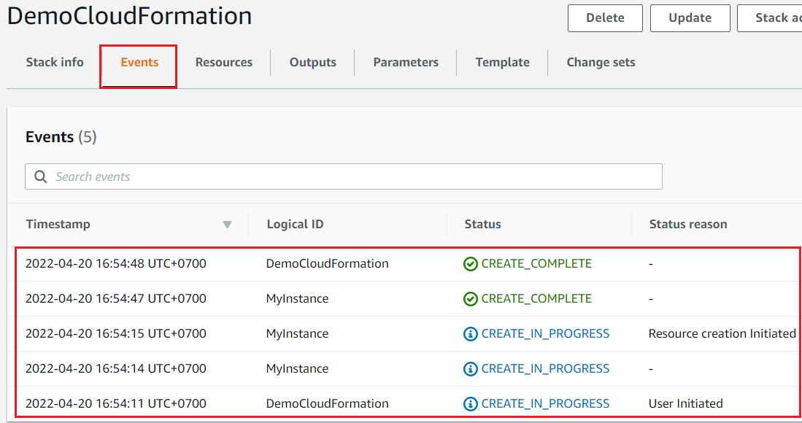
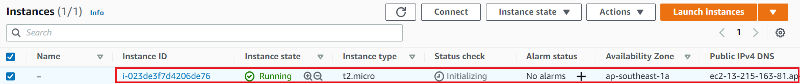
CloudFormation Service
Result

Slide 10
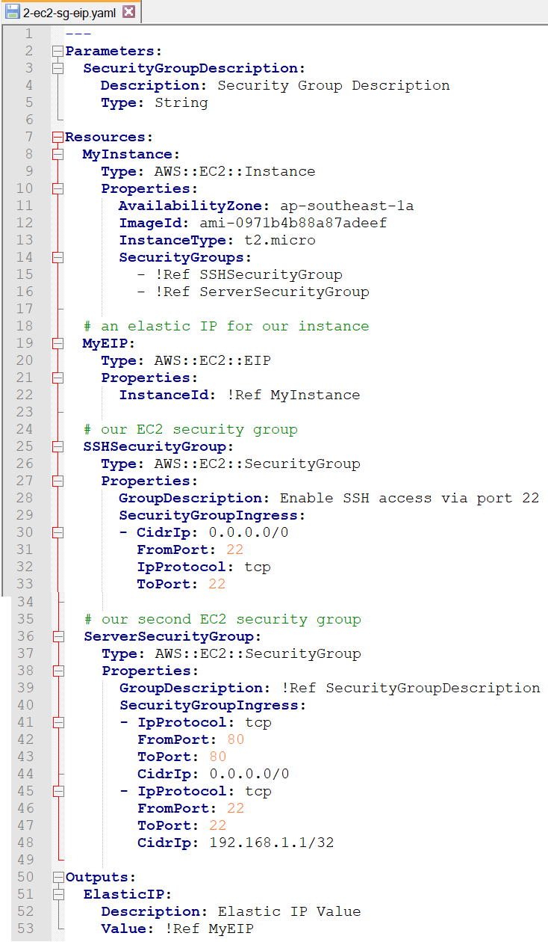
CloudFormation Service
  Update Stack
Template

Slide 11
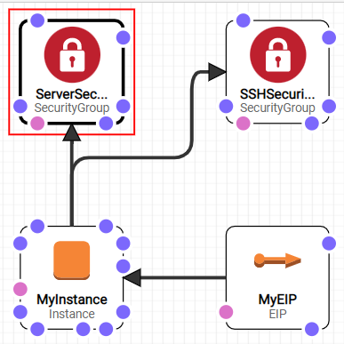
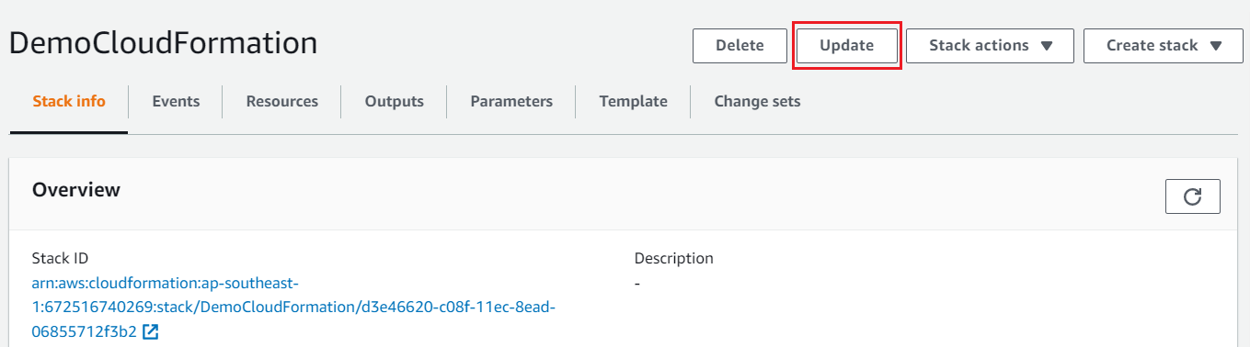
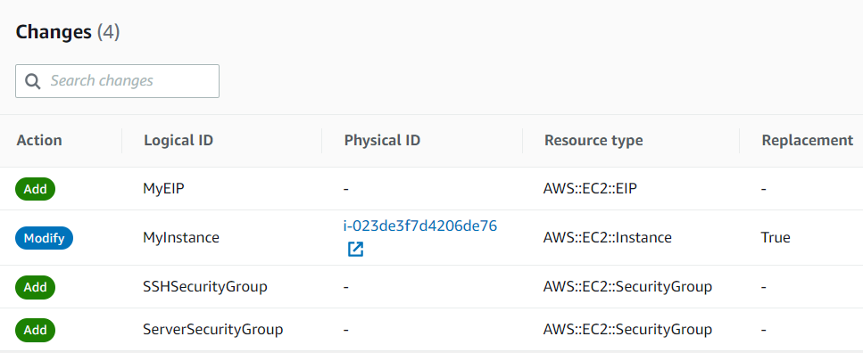
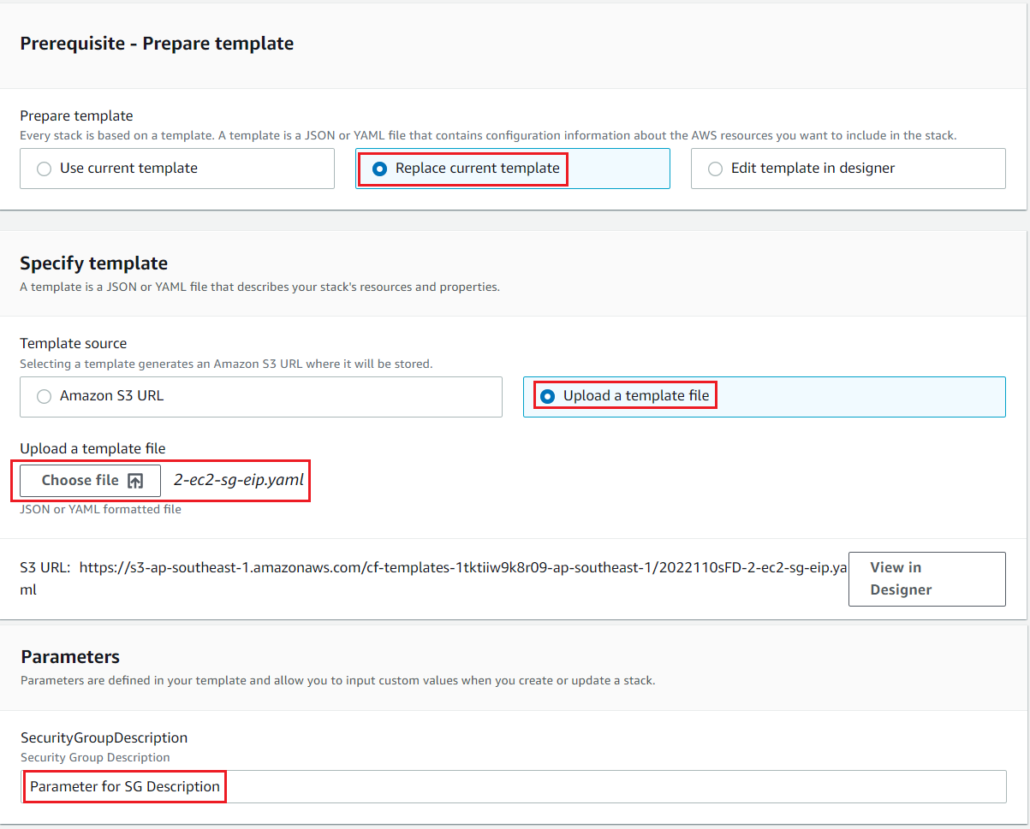
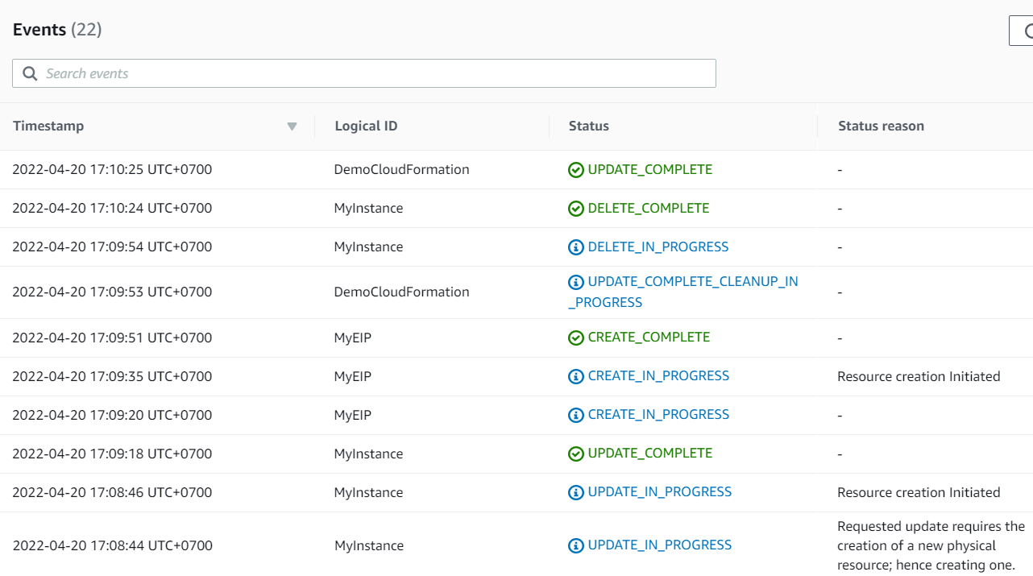
CloudFormation Service
View in Designer
Review changes

Slide 12
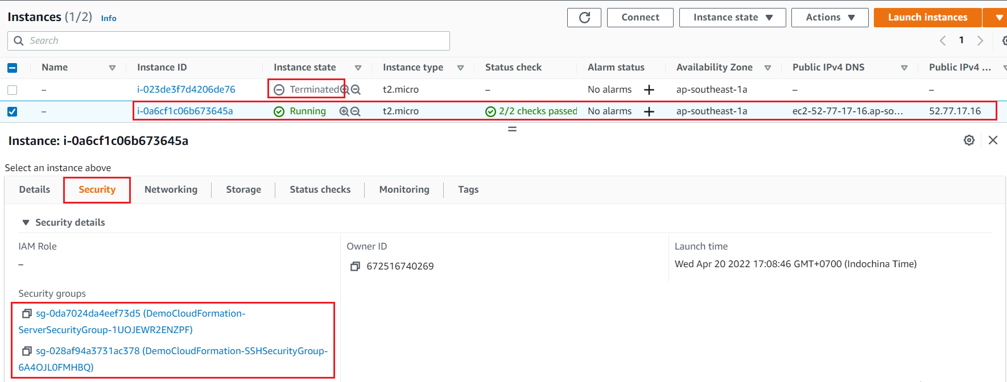
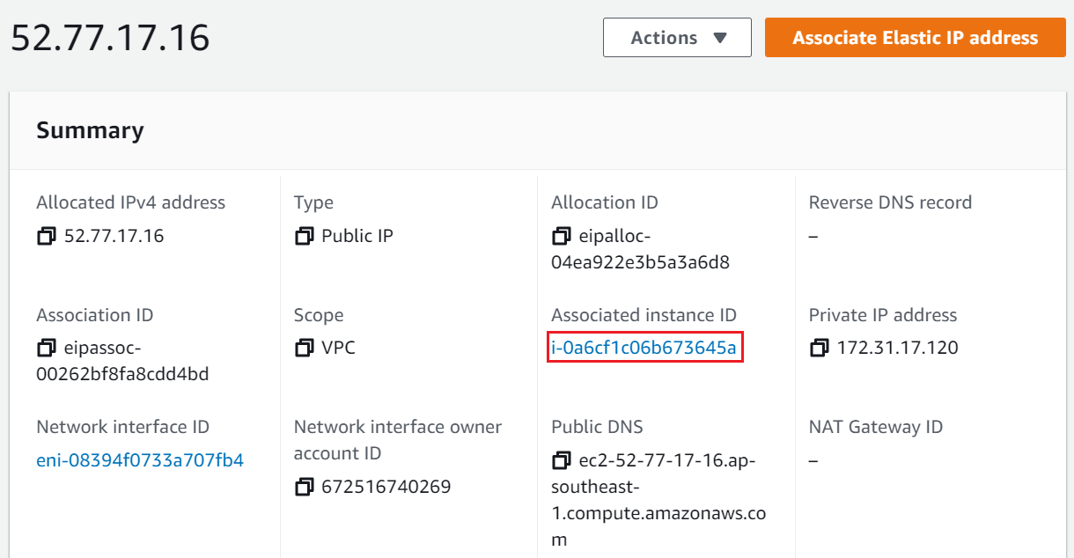
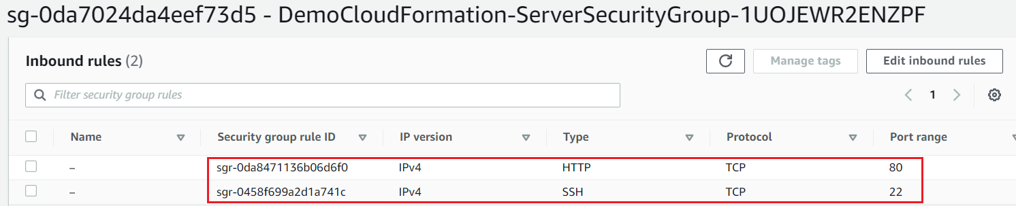
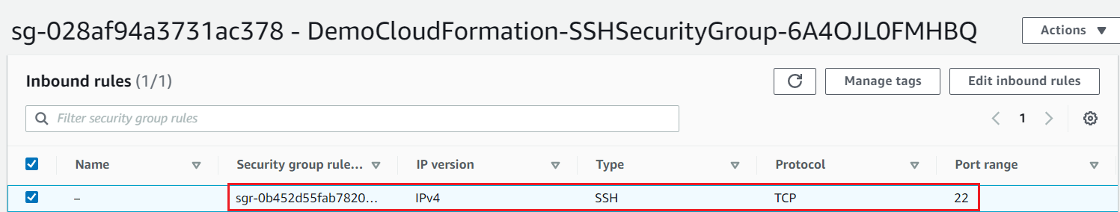
CloudFormation Service
Elastic IP
Instance
Security Groups

Slide 13
Assignment
  Self-practice

Slide 14
CloudFormation Service
Components
  Template
  Stack
  StackSet

Slide 15
CloudFormation Service
  Template
    Describe AWS resources & properties (EC2, Auto Scaling, Load balancer, RDS, ...)
    JSON, YAML format
    Support design by Editor
    Stored on S3

Slide 16
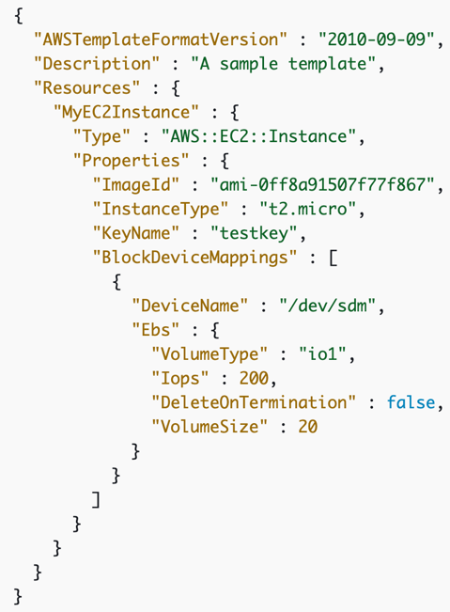
CloudFormation Service
    Components:
      Resources (Required): EC2, Auto Scaling, Load balancer, RDS, ...
      Parameters: the dynamic inputs for your template
      Mappings: the static variables for your template
      Outputs: References to what has been created
      Conditionals: List of conditions to perform resource creation
      Metadata
Tutorial

Slide 17
CloudFormation Service
  Stack
    Create Stack: config Template & Parameter for Template
    Update Stack: Update resources in stack through Change Sets
    Delete Stack: By default, AWS will delete all resources in the stack. You can keep some resources by using delete policy
Review changes when updating Stack
    Components: Template & Parameter, Permission & Role, Stack policy, Stack failure, Termination Protection, ...

Slide 18
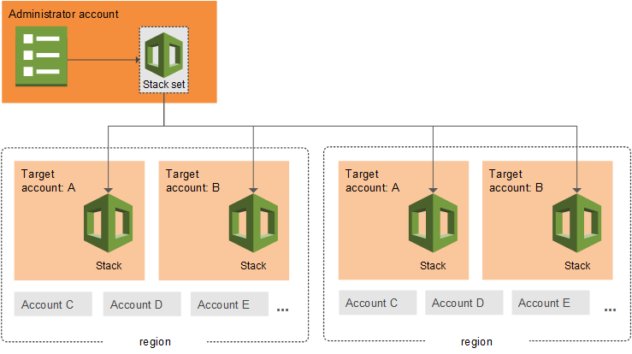
CloudFormation Service
  StackSets
    Support Create, update, or delete stacks across multiple accounts and regions
    When you update a stack set, all associated stack instances are updated throughout all accounts and regions

Slide 19
Assignment
  Self-practice

Slide 20
Summary
CloudFormation is service that allows create and manage AWS resources based on code
Infrastructure as code
Usecases
  Quickly Launch New Test Environments
  Reliably Replicate Configuration Between Environments
  Launch Applications in New AWS Regions
  Manage infrastructure with DevOps
Price: free

Slide 21
Summary
Components
  Template
    Describe AWS resources & properties (EC2, Auto Scaling, Load balancer, RDS, ...)
    Stored on S3, JSON/YAML format, Support design by Editor
    Including: Resources (Required), Parameters, Mappings, Outputs, Conditionals, Metadata
  Stack: Create/ Update/ Delete Stack
  StackSet: Support Create, update, or delete stacks across multiple accounts and regions

Slide 22
Q & A
Copyright © VTI Academy All Rights Reserved

